Slide 1
ANUPAM KUMAR SINGH / CAPSTONE
PROJECT 1
Kubernetes Cluster Health Checker, Self-Healing & Autoscaling Platform
Multicloud Architecture and DevOps Capstone Project | Hero Vired
Application Deployed
Shop Now / GratitudeApp Microservices Platform
Submitted By
Anupam Kumar Singh
anupam66kumar@gmail.com
Mentors
• Mohan Krishna
• Chirag Goel
• Prashanth Dey

Slide 2
ANUPAM KUMAR SINGH / CAPSTONE
CLOSED-LOOP MONITORING & SELF-REMEDIATING ECOSYSTEMS ELIMINATE MANUAL KUBERNETES MANAGEMENT
// PROBLEM STATEMENT
Manual Cluster Operations
Managing cloud-native clusters manually requires continuous monitoring and reactive troubleshooting.
This reactive operational model significantly increases downtime during failure scenarios and scales poorly.
// CORE GOALS & HEALTH
Automated Scrapes & Controller
Provides a closed-loop monitoring and self-remediating ecosystem designed for high availability.
k8s-cluster-healer
Custom Go controller actively scanning pod lifecycle conditions.
Utilizes a Prometheus scrape mesh coupled with controller logic to maintain high availability.
// DELIVERABLES & ACTIONS
Self-Healing Mechanisms
Automated pod remediation triggered on CrashLoopBackOff states, container exit codes, or restarts > 10.
Real-Time Observability
Unified Grafana dashboards tracking active deployments, HPA replica states, network I/O, and normalized PVC disk capacity.

Slide 3
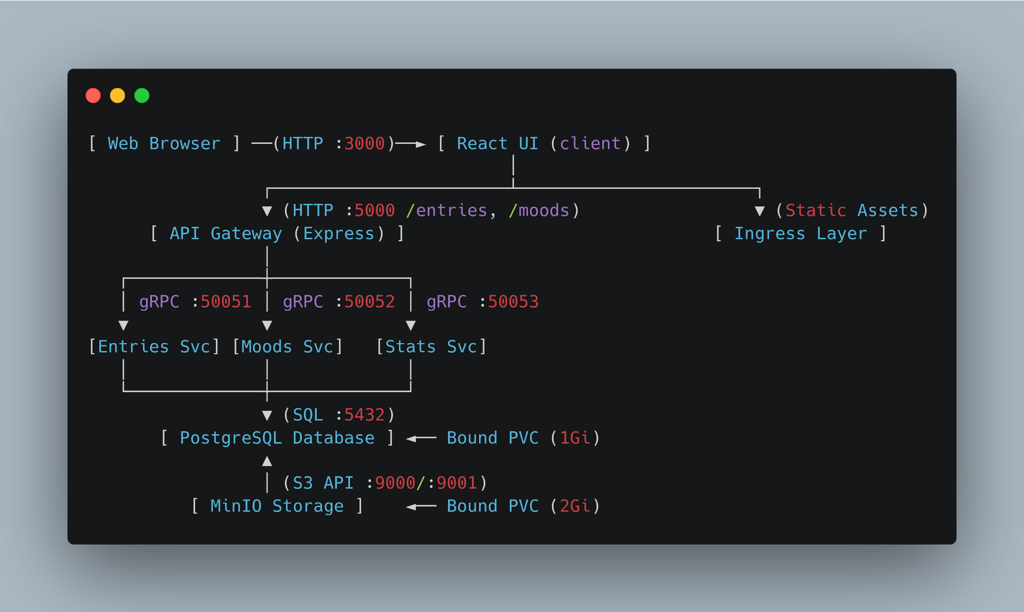
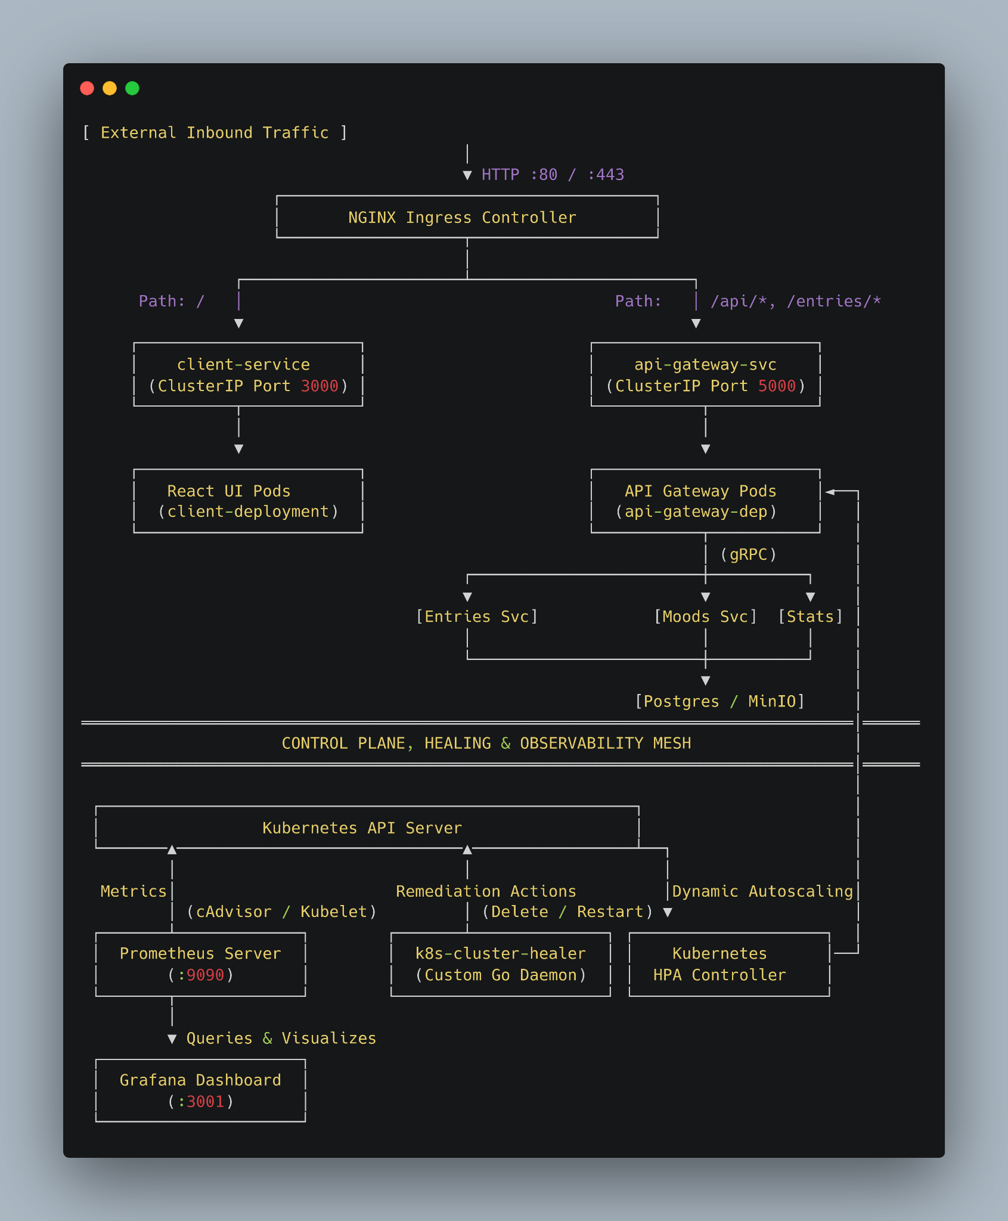
ANUPAM KUMAR SINGH / CAPSTONE
SYSTEM ARCHITECTURE
GRATITUDEAPP PLATFORM
GratitudeApp is a cloud-native microservices application designed for journal logging, mood analysis, and streak tracking.
User requests route from a React frontend through an Express API Gateway, delegating calls to domain microservices (Entries, Moods, Stats) over low-latency gRPC channels on ports 50051, 50052, and 50053.
Structured records commit to PostgreSQL (1Gi PVC), while media uploads are handled by an S3-compliant MinIO bucket (2Gi PVC).
OBSERVABILITY MESH
• Go Healer Daemon
• K8s HPA Controller
• Prometheus Metrics
• Grafana Dashboards
GO
KUBERNETES
DOCKER
GRPC
POSTGRES
MINIO
PROMETHEUS
GRAFANA
EXPRESS

Slide 4

ANUPAM KUMAR SINGH / CAPSTONE
KUBERNETES INFRASTRUCTURE
3-NODE K3D CLUSTER
Native Multi-Node Emulation & HPA Scheduling
CLUSTER NODE ARCHITECTURE
k3d-capstone-cluster-server-0 (CONTROL-PLANE)
Role: control-plane | Status: Ready | Core API Server & Controller
TOPOLOGY & TOOL SELECTION
Provisioned via k3d (over Minikube/Kind) running lightweight k3s nodes as isolated Docker containers. Consists of 1 control-plane server (server-0) and 2 worker agents (agent-0, agent-1).
agent-0 (WORKER NODE)
agent-1 (WORKER NODE)
Status: Ready
Pod Anti-Affinity Replicas
Status: Ready
Dynamic HPA Workloads
CLI VERIFICATION (kubectl get nodes)
EFFICIENCY & FOOTPRINT
Maintains a minimal base footprint of ~512MB RAM with ultra-fast startup times of 15–20 seconds. Supports seamless image imports directly into node containerd runtimes.
bash — kubectl get nodes
anupam@anupam-Ideapad-3-14ITL6:~$ kubectl get nodes
PRODUCTION-LIKE VALIDATION
• Realistic HPA Scheduling: Distributes pod replicas across distinct physical worker nodes using pod anti-affinity.
• Storage Binding: Validates Persistent Volume Claim (PVC) attachments across agent nodes.
✓ 3/3 Nodes Ready (1 Control-Plane, 2 Workers)
Version: v1.35.5+k3s1 | Engine: Containerd

Slide 5
ANUPAM KUMAR SINGH / CAPSTONE
AUTONOMOUS CLUSTER REMEDIATION
Continuous Pod Healing via Go & client-go
[01] ENGINE ARCHITECTURE
The k8s-cluster-healer is a specialized Go utility that automates cluster remediation using client-go. It solves scenarios where native Kubernetes restart policies leave broken pods lingering in backoff loops or failed states.
k8s-cluster-healer -- log-stream
# Engine loop initialized (Interval: 10s)
[INFO] 09:53:00 Starting namespace scan [default]
[DEBUG] Scanning container statuses...
[WARN] 09:53:10 Unhealthy pod detected!
Pod: broken-test-pod-7dbb9c8-x29k
Reason: CrashLoopBackOff
RestartCount: 14 (>10)
[ACTION] 09:53:10 Issuing DELETE API call...
[SUCCESS] Pod deleted. Controller provisioning fresh instance.
[INFO] 09:53:20 Scanning namespace [default]
[DEBUG] broken-test-pod-7dbb9c8-m91q STATUS: Running
[INFO] Cluster state HEALTHY. Zero broken pods lingering.
[02] SCANNING & DETECTION
Executes every 10 seconds against target namespaces, scanning container statuses for specific failure indicators:
• Waiting Reason: CrashLoopBackOff
• Explicit Error states
• RestartCount > 10 threshold
[03] REMEDIATION & VERIFICATION
When identified, an API deletion call is issued. The parent deployment controller then provisions a fresh pod replacement with a clean state.
Verification: Injected crashing workload (broken-test-pod) was detected and automatically remediated.

Slide 6
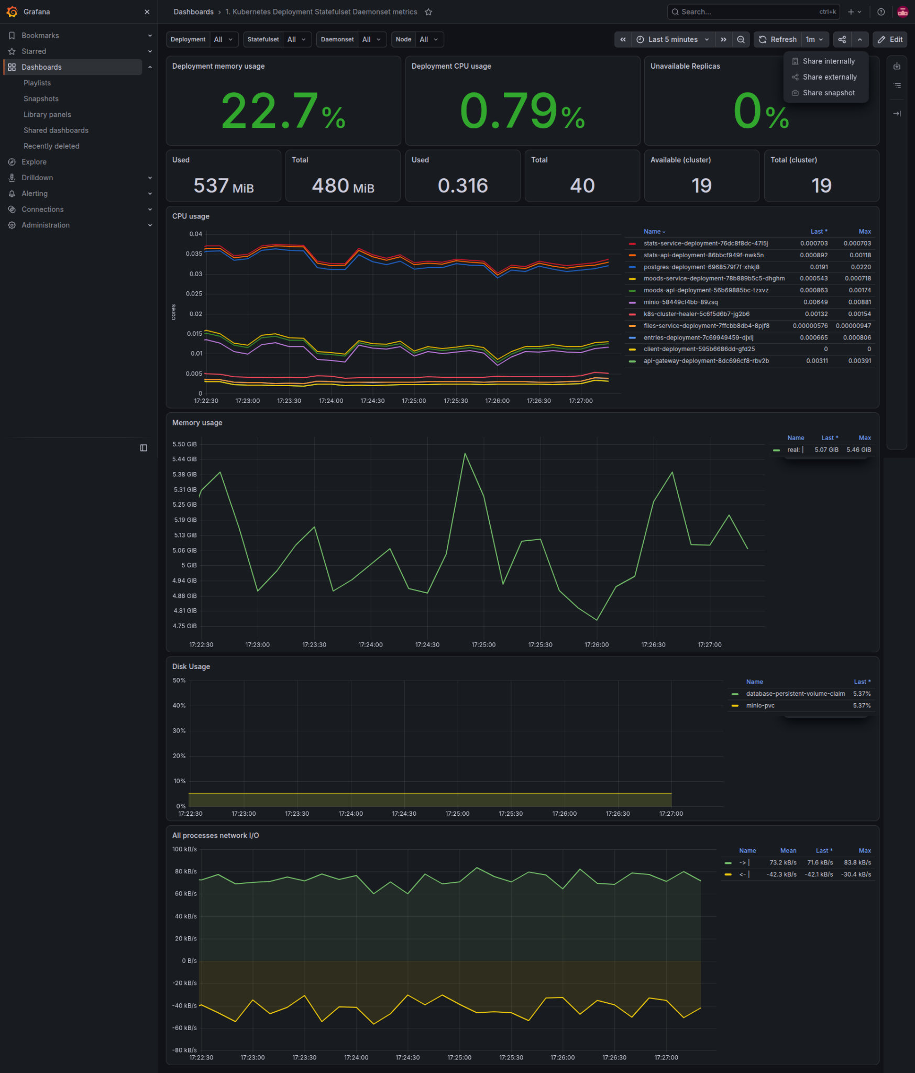
ANUPAM KUMAR SINGH / CAPSTONE
TELEMETRY & PVC VISUALIZATION
KUBE-PROMETHEUS-STACK / MONITORING-LITE
PROBE HARDENING (monitoring-lite.yaml)
Default probes were hardened to prevent false-positive kills when Prometheus replays its Write-Ahead Log (WAL) during traffic bursts.
• Initial Delay: 120s
• Timeout: 15s
PROMQL METRIC NORMALIZATION
Label aggregation via PromQL resolves multi-node label mismatches to normalize CPU, RAM, network I/O, and storage metrics across nodes.
Accurately reports Database and MinIO PVCs at utilized capacity: 4.88%.

Slide 7
ANUPAM KUMAR SINGH / CAPSTONE
HORIZONTAL POD AUTOSCALING
Dynamic Application Elasticity
TERMINAL VERIFICATION OUTPUT (kubectl get hpa)
STABILIZED POST-COOLDOWN STATE
TARGET ARCHITECTURE BOUNDS
Min Replicas: 1 | Max Replicas: 5 | Target CPU: 50%
Observed Peak CPU: 398% (Fully mitigated via scale-out)
Autoscaling responsiveness was verified under a synthetic multi-threaded load targeting the Express API Gateway. The Horizontal Pod Autoscaler (HPA) was configured with a target CPU utilization threshold of 50%.
// LOAD TEST PERFORMANCE PARAMETERS
Traffic Injection Surge: CPU utilization spiked over 280%, forcing deployment to scale dynamically from 1 to 5 replicas.
Cooldown Recovery: Post-traffic, the HPA observed the standard 5-min stabilization window before scaling back down to 1 replica at 2% CPU utilization.

Slide 8
ANUPAM KUMAR SINGH / CAPSTONE
LOCAL KUBERNETES TOPOLOGY EMULATION
Emulating enterprise Kubernetes topologies locally achieves zero-cloud infrastructure costs and prevents block storage leaks.
$0
$73/mo
<1.5 GB
INFRASTRUCTURE COST
AWS EKS BASE SAVINGS
TOTAL HOST RAM USAGE
ORCHESTRATION & STORAGE ARCHITECTURE
Emulates a 3-node Kubernetes topology locally using k3d, completely bypassing managed control planes like AWS EKS ($73/month base fee).
Utilizes a self-hosted S3-compatible MinIO instance backed by standard Linux filesystem persistence, eliminating AWS S3 bucket subscriptions and outbound egress fees.
RESOURCE TUNING & LEAK PREVENTION
Enforces tight baselines of 20m CPU and 32Mi memory requests, alongside proactive purging of orphaned storage claims (e.g., postgres-pvc).
Integrates a customized monitoring profile that fits production-grade metrics scraping inside ~1.5 GB of total host RAM.

Slide 9
ANUPAM KUMAR SINGH / CAPSTONE
ROOT CAUSE ANALYSIS & TROUBLESHOOTING
Comprehensive analysis resolves critical container runtime, storage, and metric aggregation failures across the deployment lifecycle.
01 // CONTAINER RUNTIME
ImagePullBackOff Fix
Throughout development, ImagePullBackOff errors blocked local pod instantiation in the k3d cluster environment.
Systematically resolved by explicitly importing local Docker images directly into the k3d containerd runtime.
02 // DATABASE AUTH
Secret Encoding Fix
CrashLoopBackOff authentication failures in the database were traced to invalid credential payloads during handshake.
Root cause was a trailing newline in the base64 secret encoding, resolved by re-encoding secrets cleanly.
03 // METRIC AGGREGATION
PromQL Cartesian Fix
PromQL queries displayed distorted storage numbers of 24185054000% due to multi-node label mismatches.
Successfully normalized by applying strict label aggregation and setting panel display units to Percent (0-100).
# Runtime Import Command
k3d image import \
my-app:local \
-c mycluster
# Omit Trailing Newline
echo -n "db_password" \
| base64
Err: 24185054000%
Fix: Normalized 0-100%
sum without(instance)(...)

Slide 10
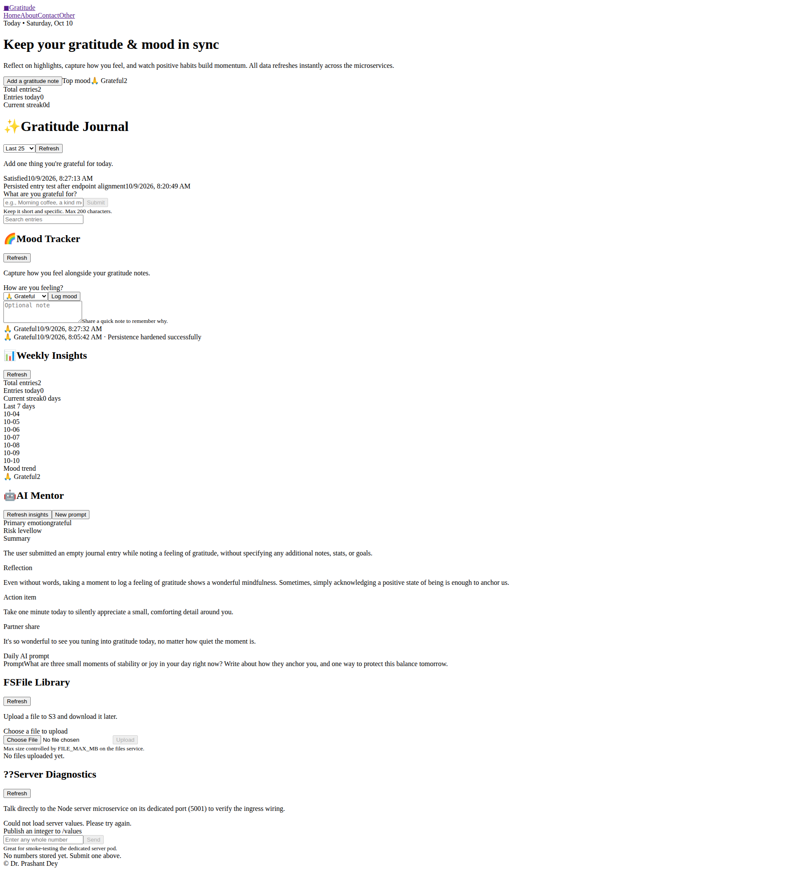
ANUPAM KUMAR SINGH / CAPSTONE
CAPSTONE COMPLETION: ZERO-COST CLOUD-NATIVE ARCHITECTURE
"The completed capstone delivers a zero-cost, production-ready cloud-native architecture with autonomous reliability."
AUTONOMOUS CLUSTER RELIABILITY
The GratitudeApp microservices platform successfully demonstrates autonomous cluster reliability through a closed-loop self-healing Go controller, Horizontal Pod Autoscaler elasticity, and full-stack observability.
PRODUCTION DELIVERABLES & INFRASTRUCTURE
The Hero Vired capstone completion includes production-ready Kubernetes manifests, custom controller code, comprehensive deployment runbooks, and a zero-cost cloud-native multi-node architecture. The platform operates entirely on-premise without incurring public cloud infrastructure expenses, utilizing tight resource bounds and local persistent storage reclamation.
DISCUSSION & OPERATIONAL METRICS
The floor is now open for questions regarding the implementation, architecture, or operational metrics.

